Slide 1
Tree Traversal
COP 4020

Slide 2
Tree Traversals
Breadth First (level-order)
Depth First

Slide 3
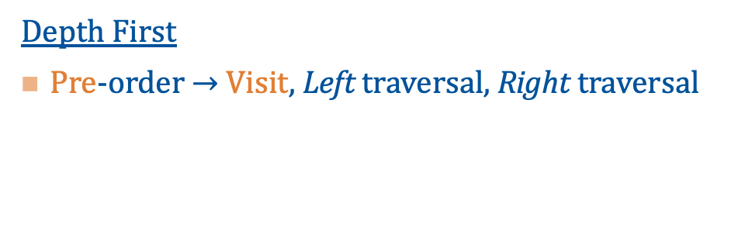
Tree Traversals
Depth First
Pre-order $→$ Visit, Left traversal, Right traversal
Visit [perform action on] the node first, before moving to another node

Slide 4

Pre-order $→$ VLR $→$ A, B, D, E, C
A
B
C
D
E

Slide 5
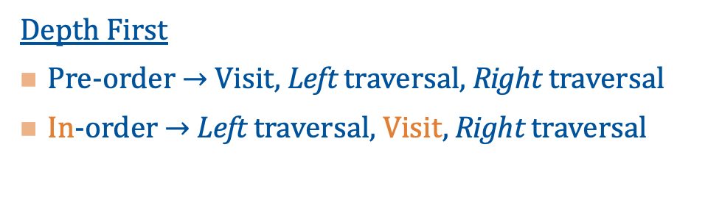
Tree Traversals
Depth First
Pre-order $→$ Visit, Left traversal, Right traversal
In-order $→$ Left traversal, Visit, Right traversal
Visit [perform action on] the node
in between moving to other nodes

Slide 6

In-order $→$ LVR $→$ D, B, E, A, C
A
B
C
D
E

Slide 7
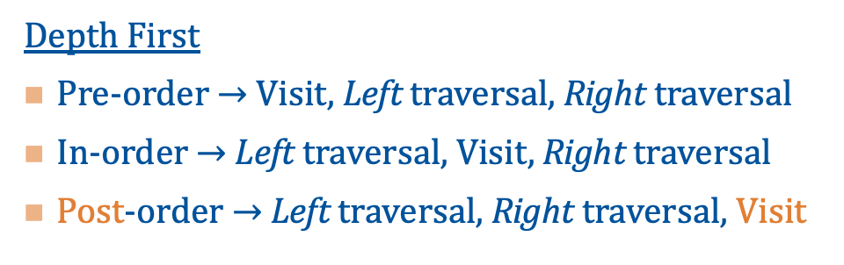
Tree Traversals
Depth First
Pre-order $→$ Visit, Left traversal, Right traversal
In-order $→$ Left traversal, Visit, Right traversal
Post-order $→$ Left traversal, Right traversal, Visit
Visit [perform action on] the node last, after moving to the other nodes

Slide 8

Post-order $→$ LRV $→$ D, E, B, C, A
A
B
C
D
E

Slide 9
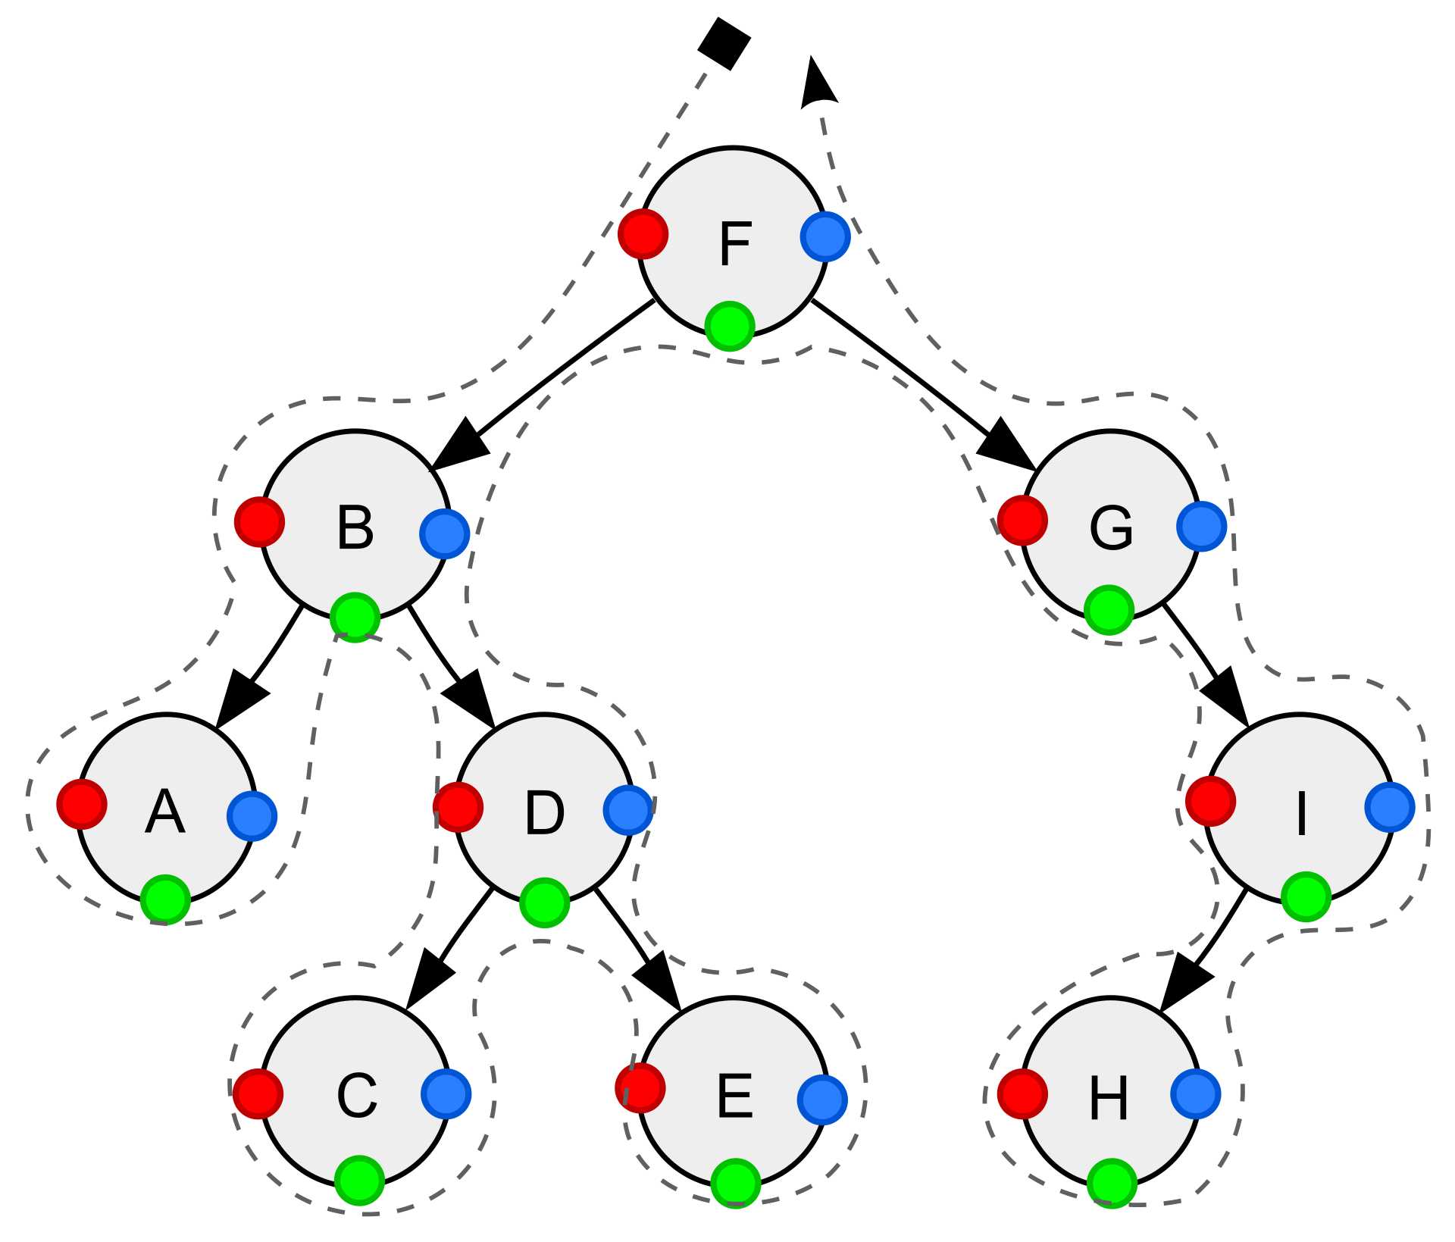
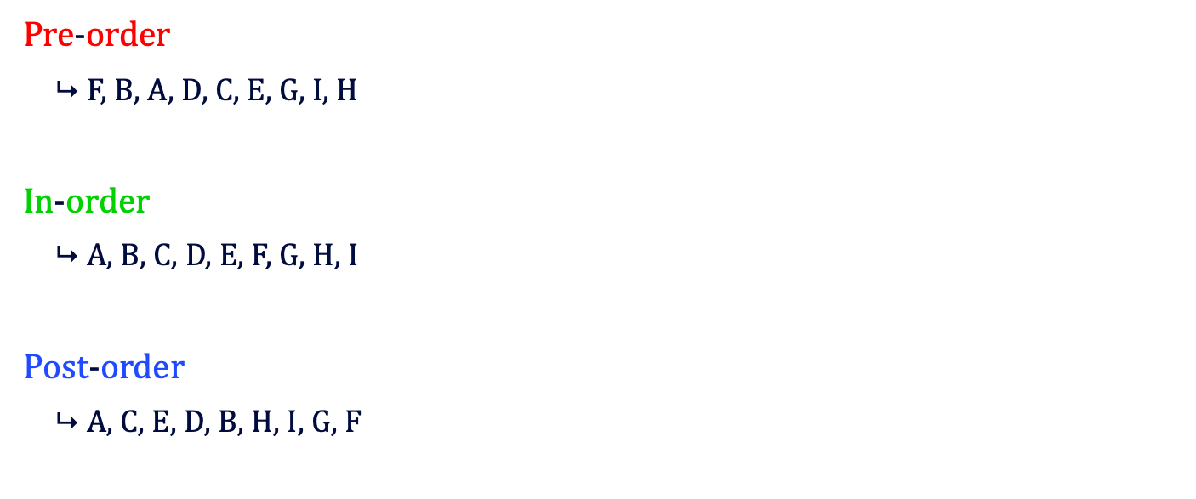
https://en.wikipedia.org/wiki/Tree_traversal
Pre-order
$\text{F}\text{, }\text{B}\text{, }\text{A}\text{, }\text{D}\text{, }\text{C}\text{, }\text{E}\text{, }\text{G}\text{, }\text{I}\text{, }\text{H}$
In-order
$\text{A}\text{, }\text{B}\text{, }\text{C}\text{, }\text{D}\text{, }\text{E}\text{, }\text{F}\text{, }\text{G}\text{, }\text{H}\text{, }\text{I}$
Post-order
$\text{A}\text{, }\text{C}\text{, }\text{E}\text{, }\text{D}\text{, }\text{B}\text{, }\text{H}\text{, }\text{I}\text{, }\text{G}\text{, }\text{F}$

Slide 10
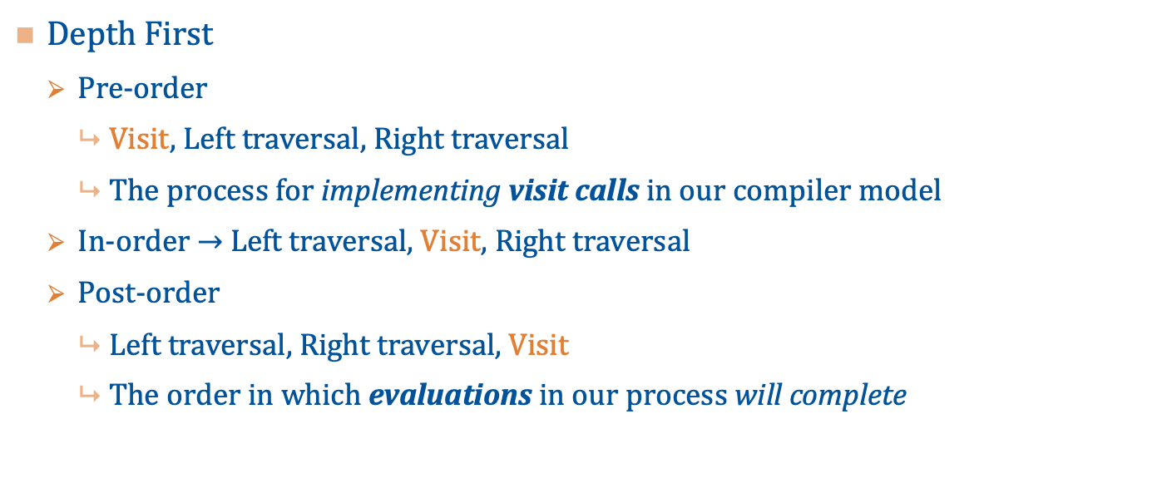
Tree Traversals
Depth First
Pre-order
Visit, Left traversal, Right traversal
The process for implementing visit calls in our compiler model
In-order $→$ Left traversal, Visit, Right traversal
Post-order
Left traversal, Right traversal, Visit
The order in which evaluations in our process will complete

Slide 11
AST Traversal
Parent
WHILE a < 10 DO
LET b = 1;
WHILE b < 5 DO
b = b + 1;
// …
END
// …
LET d = 0;
WHILE d < 7 DO
d = d + 2;
END
END
WHILE(A)
Condition
Declaration b
WHILE(B)
Declaration d
WHILE(D)
Condition
Statements

